Slide 1
Notes:
My name is Matt Kempton, I am the Chief Executive of the hospital.
Thanks for allowing me to speak to you today.
I am here today with ____________ and ____________.

Slide 2
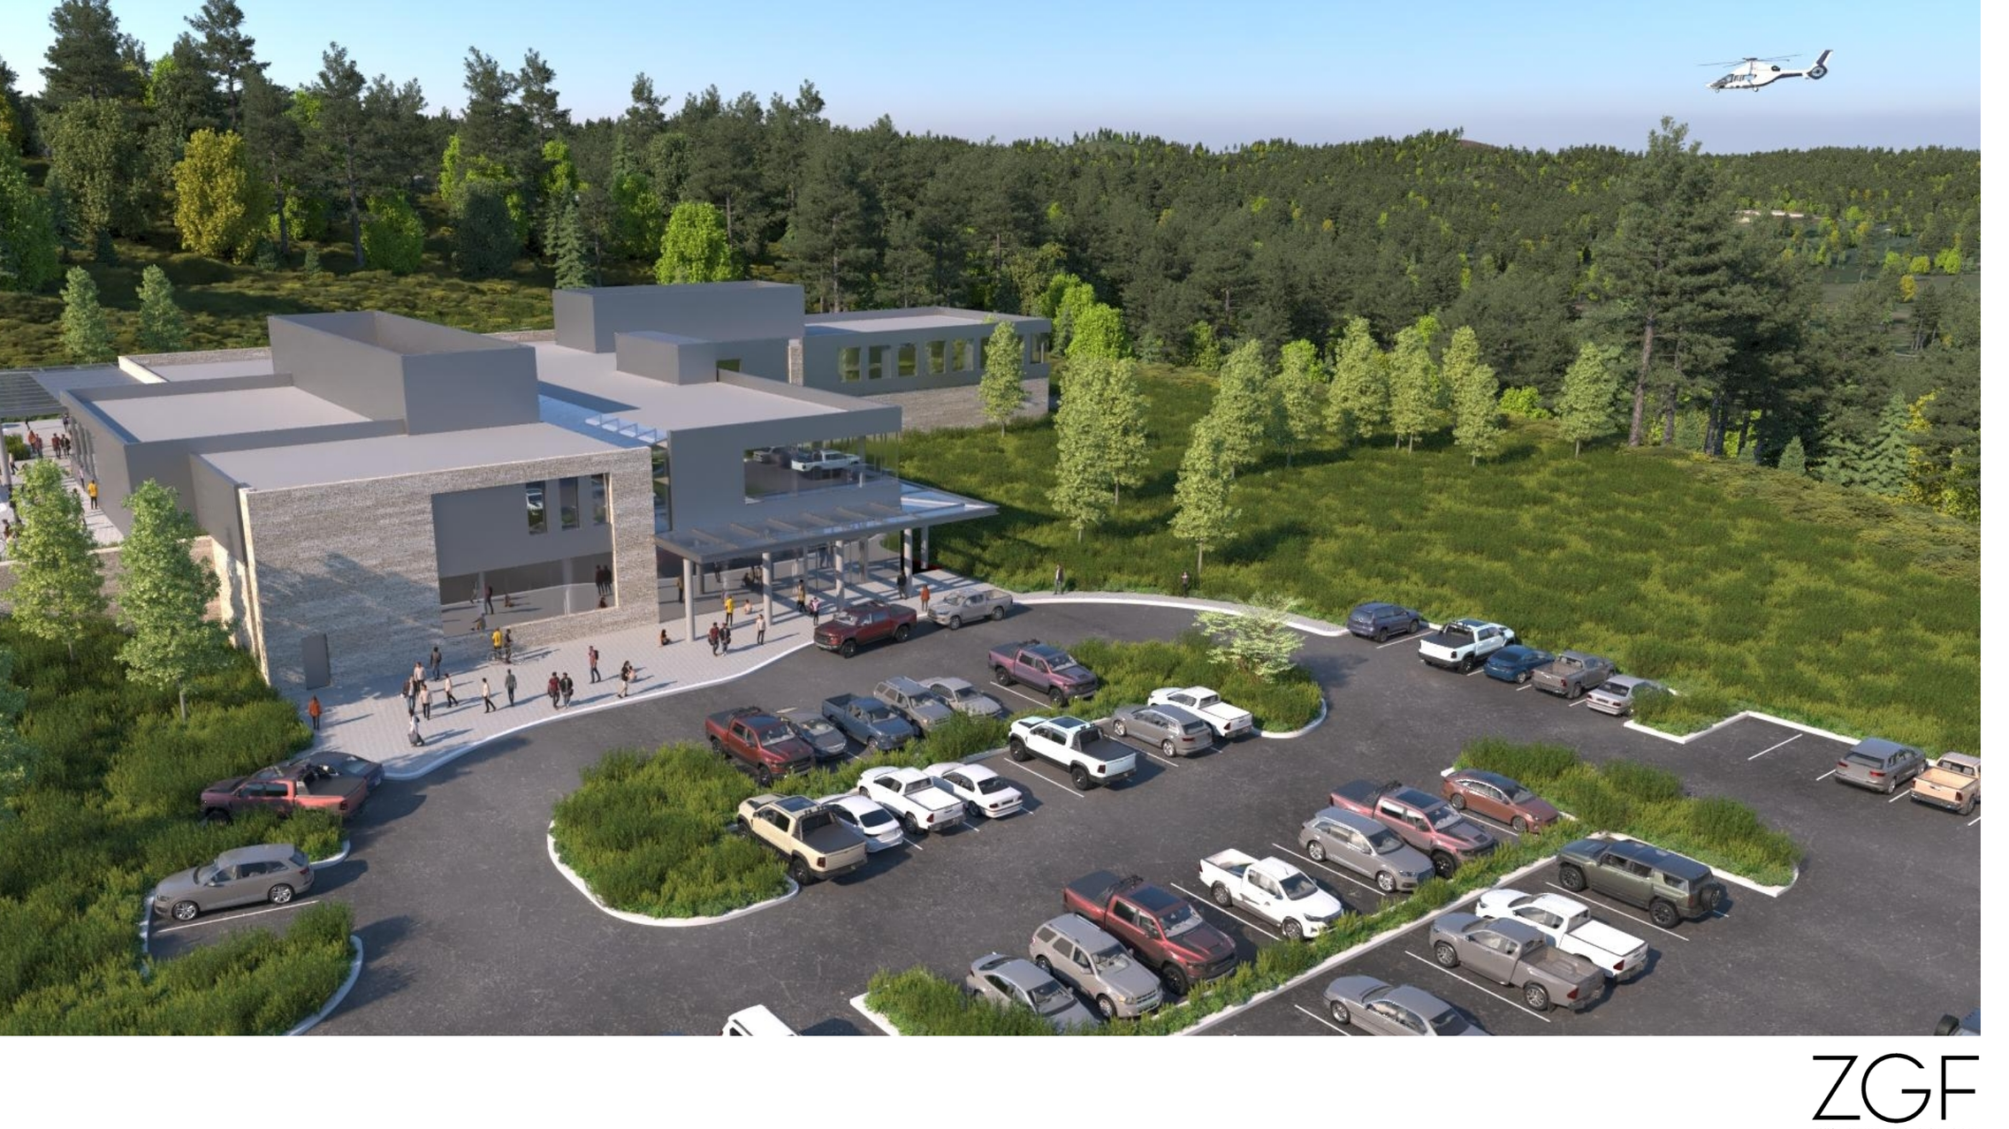
Local Care, Local Careers
A New Community Hospital for All Generations
Notes:
I want to talk with you today about the opportunity to build a new hospital here in North Pacific County.
The current hospital on the hill in South Bend was built in the early 1950’s and is over 70 years old.

Slide 3
Our patients are not a number, they are family!
Notes:
What do the services we provide every day truly mean to people in Pacific County?
Share a patient experience story

Slide 4
Why a New Hospital in North Pacific County?
We need more local services:
Chemotherapy
Orthopedics
Cardiology
Primary Care
Many other specialties
The Hospital Building on the hill in South Bend is old
Built in early 1950’s
Aging infrastructure is failing
We need space that matches modern care
Notes:
Community Health Needs Assessment 2022 – 2024 – identified 3 health priorities (from direct community feedback) Primary Care, Specialty Care, and Transportation
Severe shortage of primary care providers – We need 2 more to be comparative to state and national benchmarks – currently 3,670 people per provider
Community members identified the lack of access to specialty services as a major issue in the community (specifically they mentioned-cardiology, orthopedics, oncology, physical therapy and urology)
Our patients need services that they can access without driving 30, 50, or 70 miles or more.
We have worked hard to take good care of it, but the aging building and systems are failing.
Examples include leaking pipes and failing HVAC.
The hospital had the patient registration, laboratory, and emergency areas remodeled over 20 years ago.
No other part of the building was brought up to code at that time.

Slide 5
Did you know… A New Community Hospital would bring:
Chemotherapy services
Cardiology services
Orthopedic Surgery
An in-house MRI
More Primary Care Physicians
More specialty physicians like Urology

Slide 6
More careers for local nurses and staff

Slide 7
What will it Cost?
Approximately $15 per month per $100,000 of assessed property value
Less than a trip to Olympia
Your money stays local, We are your community hospital
*hospital taxes paid are taken off any hospital bill
Notes:
We are currently spending money on keeping the current building and systems going.
The Hospital Board considered several options, and found that building a new space was the most cost effective.
The current buildings and land area is too small for current needs.
The Board worked with architectural and financial consultants to find how much it would cost and how much needed to be financed.
The Bond that will go to the ballot on February 13, 2024 will cost property owners less than a trip to Olympia each month.

Slide 8
In 2022
Over the past 3 years we have experienced a double-digit growth!
Nearly 300 people hospitalized
Over 25,000 outpatient visits
Nearly 5,000 emergency room visits
Over 1,000 surgeries
Nearly 80,000 laboratory tests
Notes:
We currently provide care to thousands of people every year.
We know that more people would like to get care locally, without having to leave North Pacific County.

Slide 9
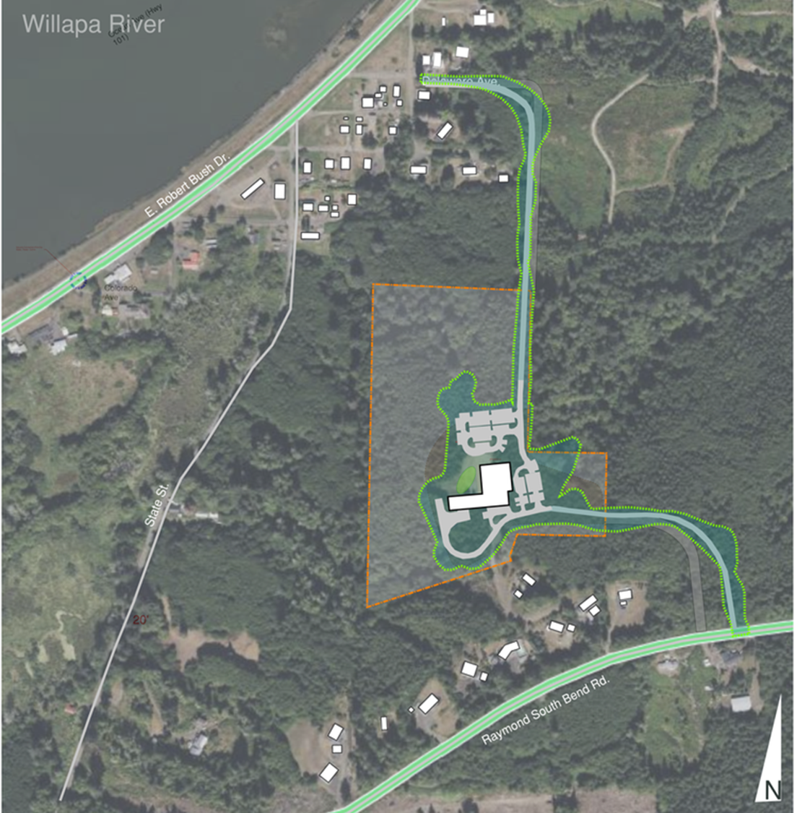
New Hospital property off Delaware Avenue
(on the hill above Canary Cottages and the Port of Willapa Harbor)

