Slide 1
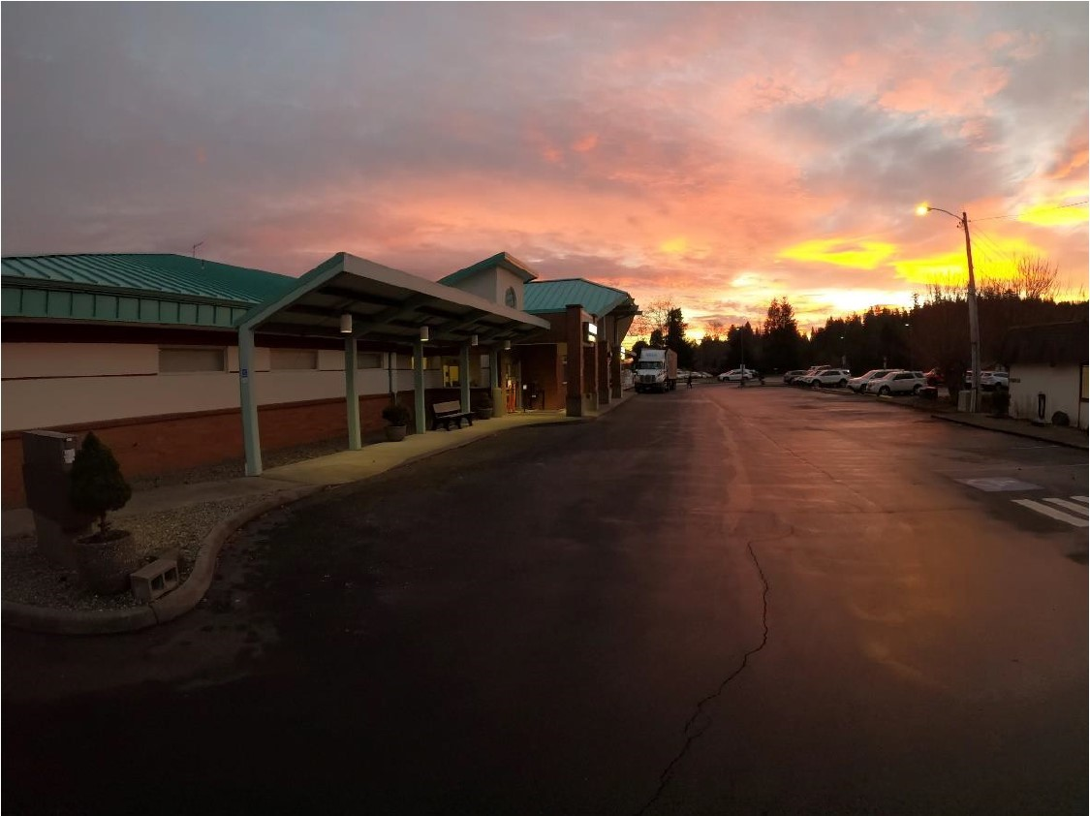
Willapa Harbor Hospital MFP Board Update
October 19, 2023

Slide 2
Agenda
Goals for today
Review of Program (ZGF)
Site Plan and schematic layout
Cost estimate
Construction
All In
Market Comparison
Next Steps

Slide 3
Since the last meeting
Tighten sf program with SLT
Test fit program on site
Identifying opportunities to tighten the construction estimate
Tighten the overall estimate

Slide 4
Cost Estimates
Construction – DCW (outside estimator) and GC review
Road, Site and Building Costs
Medical Equipment
IT/Low Voltage
Soft Costs: Design Fees, PM, Permitting, Contingencies

Slide 5
Construction Cost Estimates
Roadwork
Site
Building

Slide 6
Construction Cost Assumptions
62,000 sf program
Road – both North and South
2-story building
Construction start late spring 2025
GCCM Approach

Slide 7
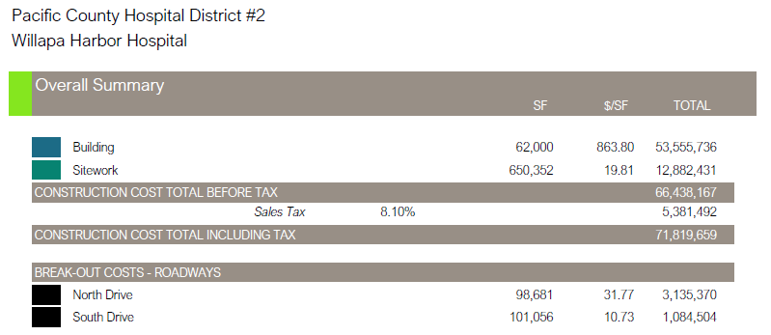
Construction Cost Estimates

Slide 8
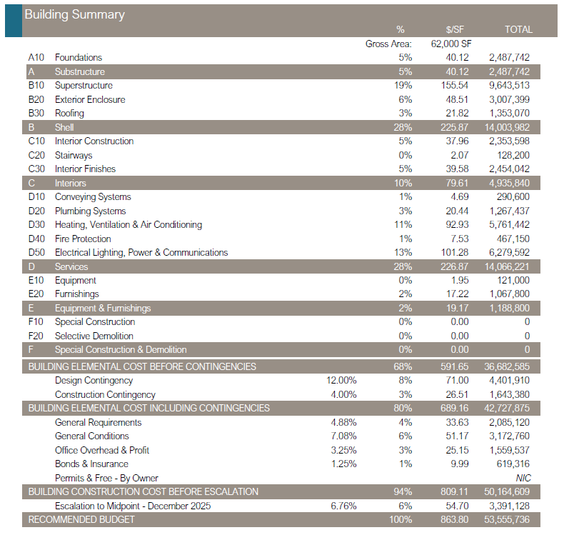

Slide 9
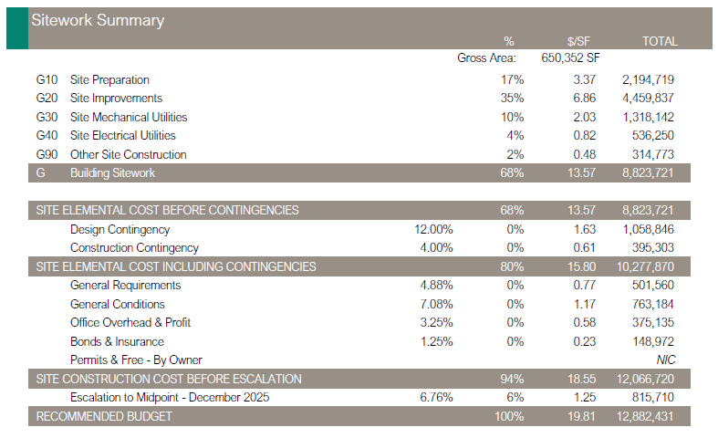

Slide 10
All In Elements
Construction – DCW (outside estimator) and GC review
Road, Site and Building Costs
Medical Equipment
IT/Low Voltage
Soft Costs: Design Fees, PM, Permitting, Contingencies

Slide 11
All In Estimate Amounts of Note
Road Work: $4,219,874
Contingencies: $7,881,649
Escalation: $4,934,032
Sales Tax: $5,977,801

Slide 12
All In Estimate
Construction: $61,626,554
Medical Equipment: $9,024,014
IT/Low Voltage: $1,850,000
Other Soft Costs: $12,898,711**
Sales Tax: $6,002,146
TOTAL PROJECT COSTS: $91,401,425
**Design Fees, PM, Permitting, FFE, Non-Construction Contingency/Escalation

